Slide 2
Content
Overview
High Level Component
Component View
Deployment Diagram
Sequence Diagrams Examples
Algorithms Examples
BCE Diagram
Requirements Traceability

Slide 3
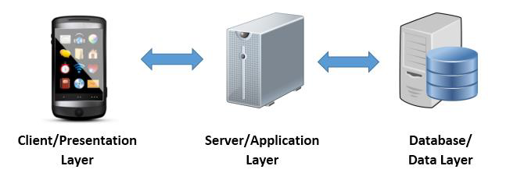
Overview
Three tier architecture:
Client
Server
DBMS

Slide 4
High level components

Slide 5
Component View

Slide 6
Deployment Diagram

Slide 7
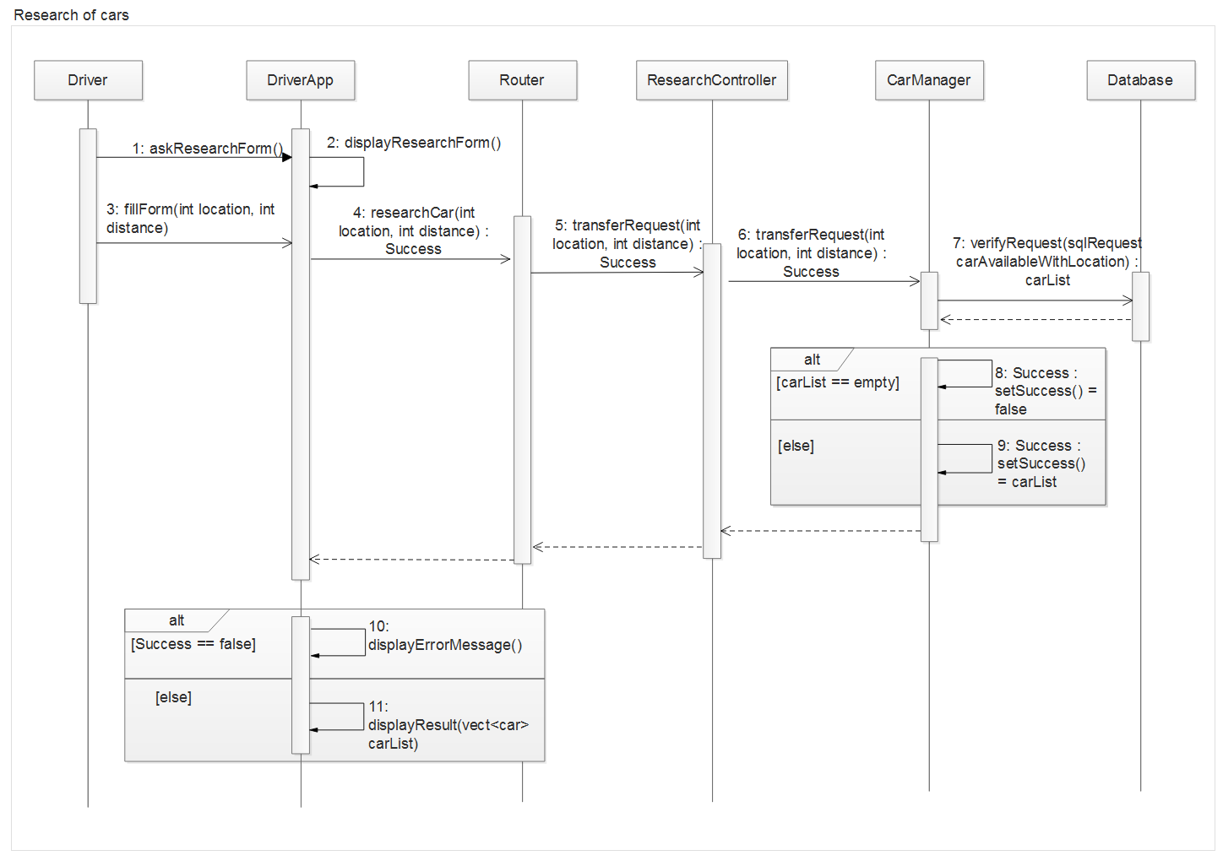
Sequence Diagram (ex 1)

Slide 8
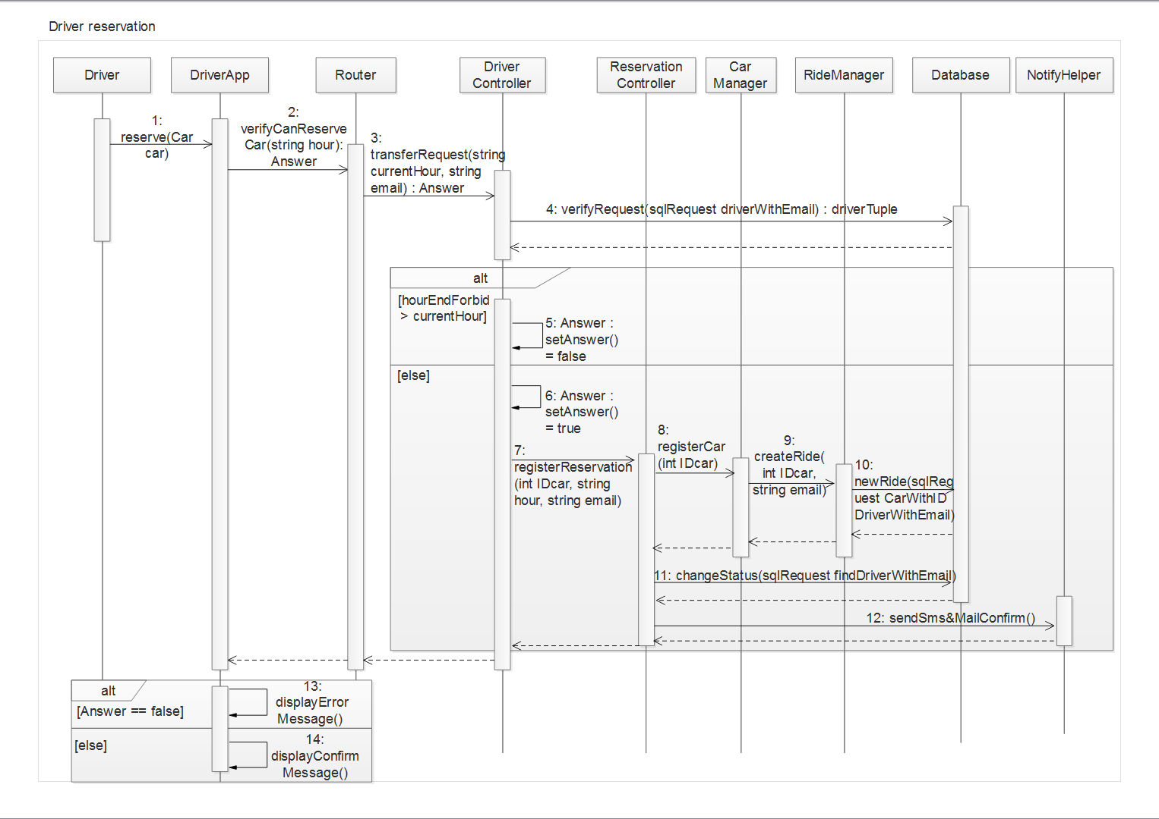
Sequence Diagram (ex 2)

Slide 9
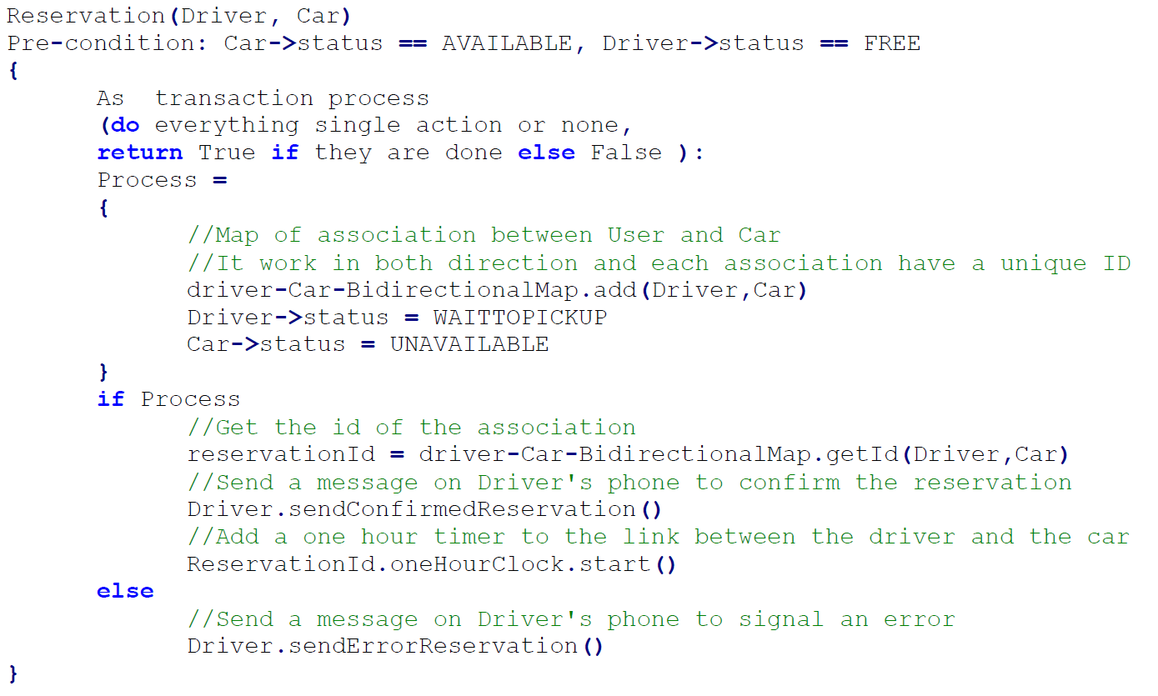
Car Reservation Algo.

Slide 10
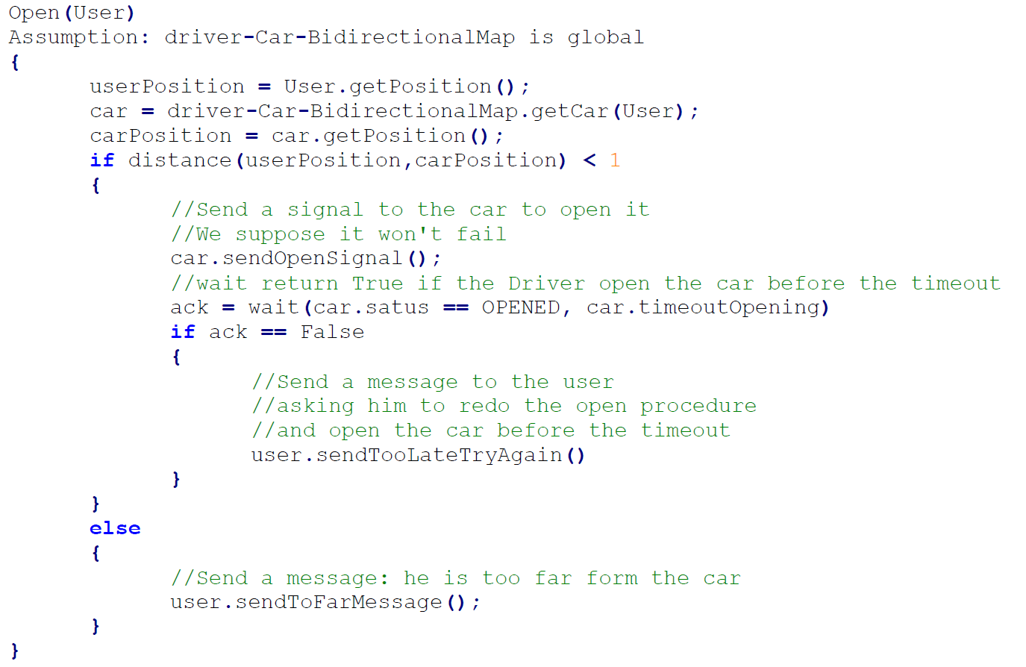
Car Unlocking Algo.

Slide 11
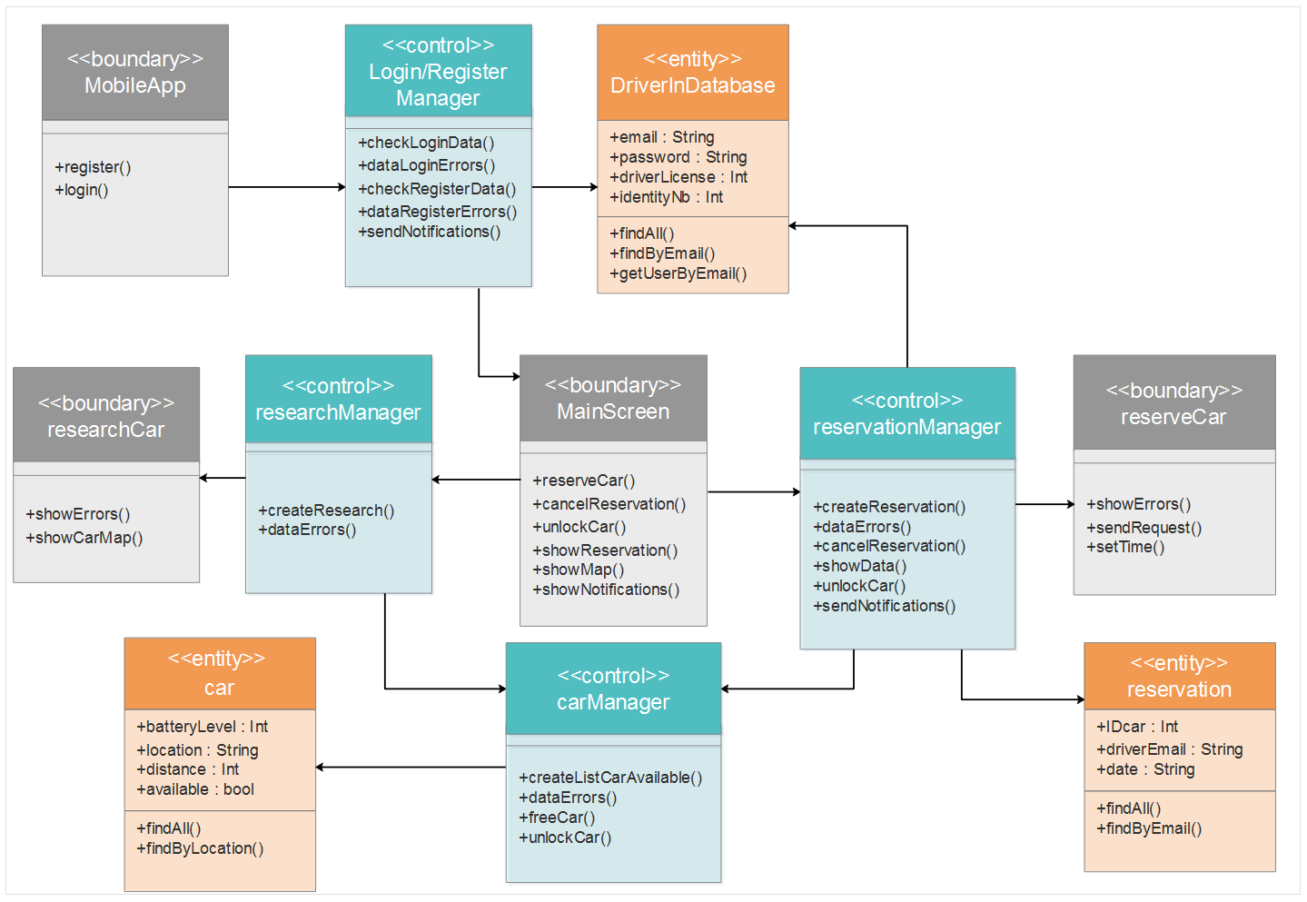
BCE Diagram

Slide 12
Requirements Traceability
G1: Allow driver to register the system by providing credential and payment details
G2: Allow driver to log into the system with provided password
G3: Driver can locate available cars within a certain distance around him or an address
G4: Driver can reserve a car for up to 1 hour before pick it up
G5: A reserved car but not picked up within one hour generate 1€ fee for the driver and forbidden him to reserve another one for few hours
G6: Driver can cancel his reservation within the hour after he reserves it.
G7: A driver close enough to a car reserved by him must be able to open it
G8: The system starts charging once engine ignite
G9: The set of safe area is predefined by the management system
G10: The system stop charging once he leaves the car parked in a safe area
G11: 10% discount on last ride if the car detects at least two passengers
G12: The system apply 20% discount on the last ride if the car is left with more than 50% battery (over full battery)
G13: If the driver parks the car in a power grid station, where the car can be charged, and takes care to plug the car. The system applies 30% discount on the last ride.
G14: If the car is left with less than 20% battery or at more than 3km from the nearest power grid station, the system charges 30% more on the last ride.
G15: The driver can enable the saving money option and so by giving his final destination to the system, this one is able to give him a station as destination and if the driver leaves the car and plugs it at this place he will get a special discount.

Slide 13
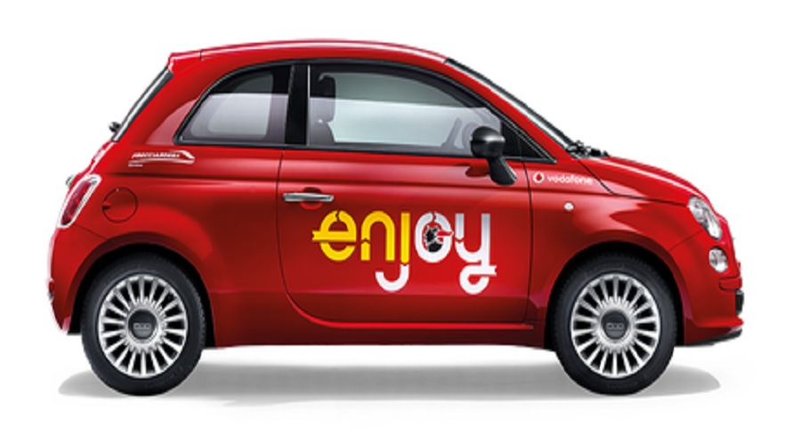
Thank you

